Slide 1
Predicting Unethical Behavior from Guilt Proneness
Taya R. Cohen^{1,} Abigail T. Panter², Nazli Turan¹
¹Carnegie Mellon University
²University of North Carolina at Chapel Hill
July 2012

Slide 2
Acknowledgments
This research was made possible through resources and funding provided by:
  Character Project at Wake Forest University & the John Templeton Foundation
  Berkman Faculty Development Fund at Carnegie Mellon University
  Center for Behavioral and Decision Research at Carnegie Mellon University
  Tepper School of Business at Carnegie Mellon University
Notes:
Feeling Bad and Doing Good: Predicting Immoral Behavior from Guilt Proneness
Taya Cohen1, Abigail Panter2; 1Carnegie Melon University, 2University of North Carolina at Chapel Hill
This research explores the role of guilt proneness in preventing immoral behavior. Guilt proneness refers to individual
differences in the propensity to feel badly about one’s transgressions, even when those transgressions occur in private. To
test whether people low in guilt proneness act more unethically, we developed the self-report Guilt and Shame Proneness
scale—GASP. Across a series of studies with the GASP, we found that people who scored high in guilt proneness
(compared to low scorers): made fewer unethical business decisions; behaved more honestly when they negotiated and
made economic decisions, and committed fewer deviant work behaviors. We found evidence of these relationships with
more than one thousand adults across the United States, as well as undergraduate and graduate students. These findings
suggest that guilt proneness is an important character trait that predisposes people to think, feel, and act in morallyrelevant
ways.

Slide 3
Guilt Proneness & Moral Character
Understanding how personality influences unethical decision making and behavior is of theoretical and practical importance for the field of business ethics.
  Yet, it is an understudied area relative to the role of situational influences.
This research examines a key aspect of personality relevant to business ethics: Guilt Proneness.

Slide 4
Guilt Proneness & Moral Character
Guilt proneness is an individual difference reflecting a predisposition to experience negative feelings about personal wrongdoing, even when the wrongdoing is private.
It is an emotional trait--the anticipation of feeling guilty about committing transgressions--rather than a specific emotional state characterized by guilty feelings in a particular moment or generalized guilty feelings that occur without an eliciting event.

Slide 5
Guilt Proneness & Moral Character
Guilt proneness is a moral character trait in that it predicts the likelihood that people will engage in unethical behavior inside and outside the workplace.
Why should guilt proneness decrease unethical behavior?
  The anticipation of guilty feelings about private misdeeds indicates that one has internalized moral values.
    Thus, for guilt-prone individuals public surveillance should not be required to prevent moral transgressions (instead, their conscience should guide them).

Slide 6
Guilt and Shame Proneness Scale
To test whether guilt proneness predicts unethical behavior, we first created a scale to measure individual differences in guilt proneness.
Guilt and Shame Proneness scale (GASP)
  4-item guilt proneness subscale
    Respondents are asked to imagine that they have committed a transgression that no one knows about, and then indicate the likelihood that they would feel badly about their behavior.
Cohen, Wolf, Panter, & Insko, 2011, JPSP

Slide 7
The GASP
Instructions: In this questionnaire you will read about situations that people are likely to encounter in day-to-day life, followed by common reactions to those situations. As you read each scenario, try to imagine yourself in that situation. Then indicate the likelihood that you would react in the way described.
1 | 2 | 3 | 4 | 5 | 6 | 7
Very Unlikely | Unlikely | Slightly Unlikely | About 50% Likely | Slightly Likely | Likely | Very Likely

Slide 8
Guilt Proneness Items
After realizing you have received too much change at a store, you decide to keep it because the salesclerk doesn't notice. What is the likelihood that you would feel uncomfortable about keeping the money?
You secretly commit a felony. What is the likelihood that you would feel remorse about breaking the law?
At a coworker’s housewarming party, you spill red wine on their new cream-colored carpet. You cover the stain with a chair so that nobody notices your mess. What is the likelihood that you would feel that the way you acted was pathetic?
You lie to people but they never find out about it. What is the likelihood that you would feel terrible about the lies you told?

Slide 9
Guilt Proneness and Moral Disposition
Guilt proneness correlates with other moral personality measures (online survey 1,514 U.S. adults)
  Honesty-Humility: r = .50*
  Empathic Concern: r = .46*
  Perspective Taking: r = .37*
  Moral Identity–Internalization: r = .41*
  Moral Idealism / Relativism (EPQ): r = .35* / -.24*
  Consideration of Future Consequences: r = .35*
  Cognitive moral development (DIT N2 score): r = .17*
  Self-control (N = 495): r = .30*
  Exploitiveness-Entitlement (Narcissism): r = -.35*
  Machiavellianism (N = 495): r = -.50*
*p < .05
Cohen, Panter, Turan, & Morse, 2012, www.WECTproject.org

Slide 10
Predicting Deceptive Behavior
Investigated unethical behavior with an economic decision-making task: deception game (Cohen, Gunia, Kim-Jun, & Murnighan, 2009)
  Individuals can potentially gain money by deceiving another person.
  Participants had to decide whether to lie to another participant to potentially earn $50 rather than $25.
79 adults completed the GASP and an online version of the deception game
  Described as a “decision-making task” in which they would interact with another individual who was also completing the task.
  For every 100 people who participated in the study, one would be selected at random to receive the money they earned in the task.
Cohen, Wolf, Panter, & Insko, 2011, JPSP, Study 2

Slide 11
Deception Game
Sender (you) and Receiver (other person)
You learn of two payment options
Payment Options | Option A | Option B
You receive: | $25 | $50
Other person receives: | $50 | $25
Other person (not you) must choose payment option.
Other person’s payment table is blank.
The only info other person has about the payment options is what you choose to provide in a message.

Slide 12
Message Choice
You (Sender) must choose which message to send to the other person (Receiver)
Message Choices
Message 1: Option A will earn the Receiver more money than Option B. (True)
Message 2: Option B will earn the Receiver more money than Option A. (Lie)
If Receiver believes message, lying allows you (the Sender) to earn $50 instead of $25.

Slide 13
Important Information
You (the SENDER) have been randomly assigned to send a message AFTER the RECEIVER chooses whether to follow the recommendation you provide in your message.
  At this time, please click Next to find out whether the RECEIVER has decided to follow the recommendation you provide in your message.
The RECEIVER has decided to follow the recommendation you provide in your message. That is, the RECEIVER has decided to choose whichever payment option you identify as giving the RECEIVER more money. The RECEIVER's decision is final and binding.
  At this time, please think about which message you would like to send. After you have made your decision, select your choice.

Slide 14
Open-Ended Responses
After selecting the message choice, participants were asked “Why did you choose this message?”
  We verified that all participants understood the procedure and chose the message they intended.
Participants who selected the truth indicated that they were concerned with honesty or did not want to lie.
  Example: “Knowing that the sender made a binding selection, I felt it was important to be honest select the true message.”
Participants who lied indicated a self-interested desire to earn money.
  Example: “I was told that the Receiver was definitely going to choose the option that I recommended. Message 2 gives me, the sender, more money in the end.”

Slide 15
Results
Highly guilt-prone adults lied less.
  Adults with high scores on guilt proneness were less likely to choose the deceptive message than those with low scores on guilt proneness
    Logistic regression of choosing to lie: B = -.44, SE = .20, odds ratio = .64, p = .03

Slide 16
Negotiation Study
Does guilt proneness predict unethical negotiation behavior?
56 MBA students at Northwestern University completed the guilt proneness scale in an online survey.
  Half the Ps completed it during week 1 and half completed it during week 4.
    Timing had no effect so we collapsed across this variable.
In week 5, students were randomly assigned to be an agent for a buyer or a seller in a class exercise involving a real-estate negotiation (“Bullard Houses”; Karp et al., 2008).
Cohen, Wolf, Panter, & Insko, 2011, JPSP, Study 3

Slide 17
Negotiation Study
In the Bullard Houses negotiation, there is considerable pressure on students in the role for the buyer’s agent to act unethically (e.g., by lying about who the buyer is or what the buyer intends to do with the property).
Analyses focused on unethical behavior exhibited by the buyers as judged by the sellers.
  “Yes-No” checklist of whether their counterpart committed 13 unethical negotiation behaviors (e.g., misrepresentation, making false promises, inappropriate information gathering)
  How honest was the other party in the negotiation? (1 = not at all honest, 7 = very honest).

Slide 18
Results
  Buyers high in guilt proneness committed fewer unethical negotiation behaviors than buyers low in guilt proneness (as judged by the sellers): r = -.53, p = .004
  High guilt buyers were judged as more honest by the sellers: r = .43, p = .03.
  Unlike the prior studies, this study assessed guilt proneness one to four weeks prior to the outcome and focused on behaviors as judged by peers.

Slide 19
Counterproductive Work Behavior
Counterproductive work behavior (CWB) is volitional behavior that harms or intends to harm organizations or people in organizations (Fox & Spector, 2005)
  Includes abuse, production deviance, sabotage, theft, and withdrawal behaviors.
411 employed adults in the U.S. (recruited from Amazon MTurk)
  Described job and organization, completed GASP and work-related questions (in a randomized order)
  Respondents indicated how often they engaged counterproductive behaviors during the past week at work (CWB-C; Spector et al., 2006)
    Meta-analysis found that self-reports of CWB provide more accurate and valid measurement than co-worker or manager reports (Berry, Carpenter, & Baratt, 2012).
Cohen, Panter, & Turan, 2012, Journal of Business Ethics
Notes:
Guilt proneness predicts lying for economic gain, but what about other unethical behaviors? Specifically, what about unethical workplace behaviors?

Slide 20
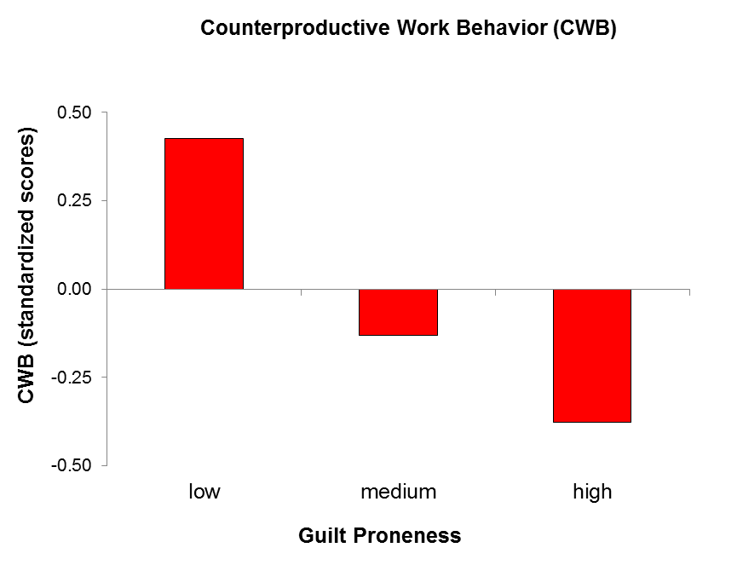
Guilt proneness correlated -.33 with CWB.
The graph displays the frequency of CWB over the course of seven days by 411 U.S. employees low, medium, and high in guilt proneness (recruited from Amazon MTurk).
Cohen, Panter, & Turan, 2012, Current Directions in Psychological Science

Slide 21
Guilt proneness predicted CWB controlling for other known correlates of CWB.
Regression of CWB Scores | β | t | p
Constant |  | 5.53 | <.001*
Guilt Proneness | -.21 | -5.13 | <.001*
Gender (0 = male, 1 = female) | -.10 | -2.48 | .01*
Age (in years) | -.09 | -1.84 | .07+
Hours worked during past week | -.02 | -.38 | .71
Tenure at job (in months) | .03 | .65 | .52
Job Satisfaction | .09 | 1.59 | .11
Intention to Turnover | .12 | 2.58 | .01*
Interpersonal Conflict | .39 | 9.05 | <.001*
Negative Affect at Work | .22 | 4.69 | <.001*
Positive Affect at Work | .00 | -.04 | .97
Cohen, Panter, & Turan, 2012, Journal of Business Ethics

Slide 22
Self-Observer Agreement & Stability
We investigated self-observer agreement and stability of guilt proneness and personality traits among well-acquainted individuals in two different samples of adults:
  A community sample from Pittsburgh, Pennsylvania (Study 1)
  An online panel of employed adults from across the U.S. (Study 2).
  We were interested in comparing self-observer agreement and stability of guilt proneness with the HEXACO / Big Five dimensions
    Honesty-Humility, Emotionality, Extraversion, Agreeableness, Conscientiousness, and Openness to Experience
Cohen, Panter, Turan, & Morse, submitted

Slide 23
Study 1
Participants recruited in pairs from Pittsburgh streets for a 15-minute computerized survey.
Measures (answered for self and for peer)
  Guilt Proneness (GASP; Cohen et al., 2011)
  Honesty-Humility (10 items from HEXACO-60; Ashton & Lee, 2009)
  Ten-Item Personality Inventory of Big5 Traits (TIPI; Gosling, 2003)
Criterion Variables (answered only for self)
  Unethical Business Decisions (UBD) scale (Ashton & Lee, 2008)
    Ps asked to make decisions in 3 dilemmas (chosen randomly from a group of 6) that pit financial interests against ethical concerns.
  Delinquency Inventory (Ashton & Lee, 2008)
    Ps asked about the number of times they have stolen, broken the law, etc.

Slide 24
Study 2
Work Experiences and Character Traits Project (WECTProject.org)
  Three-month weekly online diary study of employed U.S. adults.
  Participants completed 14 surveys over 3 months and had a coworker complete a survey about them.
Initial & Final surveys (approx. 60 to 75 minutes)
  Assessed guilt proneness and the six HEXACO factors (among other variables)
  Initial and final surveys completed 13 weeks apart
Coworker survey (approx. 45 to 60 min)
  One month after completing the initial survey, participants were asked to provide an email address of a current coworker. Coworkers were emailed a survey invite.
  Assessed coworkers’ judgments of participants’ guilt proneness and HEXACO factors (among other variables)

Slide 25
Self-Observer Correlations
 | Study 1 r | Study 2 r
Guilt proneness | .44 | .50
Honesty-Humility | .47 | .56
Emotionality | .39 | .57
Extraversion | .57 | .68
Agreeableness | .23 | .59
Conscientiousness | .33 | .60
Openness to Experience | .25 | .69
Self-observer correlations for Guilt Proneness were just as high as correlations for Honesty-Humility, Agreeableness, and Emotionality.
Correlations were not as high as for Extraversion.
Findings were mixed for Conscientiousness and Openness to Experience.
Study 1 N = 88 dyads; Big Five personality assessed with TIPI.
Study 2 N = 341 dyads; Big Five personality assessed with HEXACO-60.

Slide 26
Self-Observer Agreement
Observers in both Study 1 and Study 2 knew their counterpart very well (mean ratings of 4 on a 5-point scale, where 5 = extremely well).
Moral character is observable by friends and coworkers who know each other well.
  Future research should investigate whether moral character traits, like guilt proneness, are observable in low-acquaintance settings (e.g., during a job interview).

Slide 27
Correlations with Criterion Variables (Study 1)
 | Self-Reports rs with Unethical Decisions | Observer-Report rs with Unethical Decisions | Self-Report rs with Delinquency | Observer-Report rs with Delinquency
Guilt proneness | -.42* | -.26* | -.38* | -.29*
Honesty-Humility | -.37* | -.33* | -.29* | -.33*
Emotional Stability | .02 | .01 | -.07 | .00
Extraversion | .03 | .01 | .17* | .18*
Agreeableness | -.20 | -.05 | -.07 | -.07
Conscientiousness | -.14 | -.02 | -.13 | -.13*
Openness | -.03 | -.04 | .15* | -.03
Note. Study 1. N = 88 dyads. Big Five personality assessed with TIPI.

Slide 28
Stability (Study 2)
Guilt proneness and the six HEXACO dimensions were all found to be quite stable between the initial and final surveys.
Test-retest correlations for Guilt Proneness and Honesty-Humility were smaller in magnitude that the other HEXACO dimensions.
  May suggest that moral character is less stable than personality.
Test-Retest Correlations (rs) 3 months (N = 845 employed adults)
Guilt proneness | .67
Honesty-Humility | .66
Emotionality | .75
Extraversion | .78
Agreeableness | .74
Conscientiousness | .71
Openness to Experience | .83

Slide 29
Conclusions & Implications
Managers must be vigilant not only about creating ethical organizational climates and cultures (i.e., designing—good rather than--bad barrels), but also be vigilant about selecting ethical individuals for their organizations (i.e., hiring ―good rather than ―bad apples; Kish-Gephart et al., 2010).
Guilt proneness is an important character trait.
  People who are high in guilt proneness are less likely to lie for economic gain, act unethically in negotiation, commit counterproductive and delinquent behaviors, and make unethical business decisions.

Slide 30
Conclusions & Implications
Knowing that guilt proneness is (1) an important dimension of moral character, and (2) a potentially observable characteristic suggests that targeted interviewing could focus on uncovering these traits.
  An important avenue for future research is to determine how observers become knowledgeable of a person’s moral character.
Should a technique for detecting moral character traits in low-acquaintance situations be developed, it would have tremendous managerial implications for personnel selection and promotion.

Slide 31
Thank you!
Taya Cohen: tcohen@cmu.edu

